Slide 1
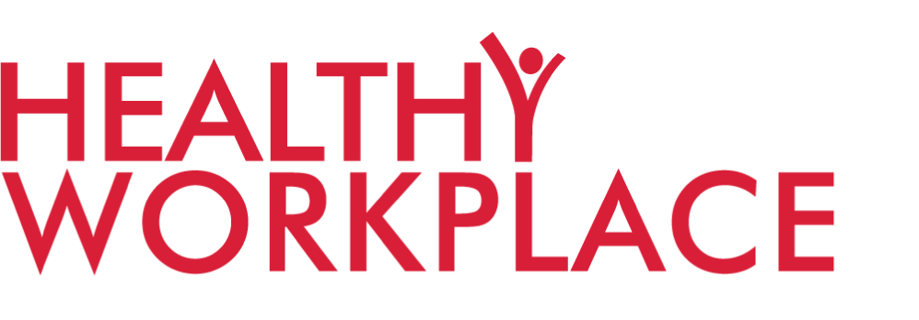
HEALTHY SCHOOLS
REACH: 0.75 MILLION adolescents (11-14 yr old)
IMPACT: 15% improvement in awareness and behavior change
REACH: 1.5 MILLION adults across India
IMPACT: >20% improvement in multiple health behaviors known to prevent diabetes
REACH: 26 MILLION people on social media,
>50 million readers on Traditional media
IMPACT: 8% engagement as per Nielsen’s analysis (880,000 engagement on reach of 10.8 million:Aug 21 - March 22 - Urban MyThali)
REACH: 186 companies, 5.8 million employees, 100 Lifestyle Coaches trained
WHAT WE TRACK
Reduction in smoking or usage of Tobacco by employees
Increase in number of employees who exercise regularly
Reduction in stress, attrition & absenteeism
Increase in employee engagement & productivity
REACH: >0.5 MILLION people & 21 Pledgemakers
WHAT WE TRACK
Number of people screened for NCDs
Number of people educated on healthy living
Number of adolescents educated on healthy behavior
Increase in intake of 2-3 fruits a day and 2-3 vegetables a day
WHAT WE TRACK
Awareness that diabetes can
be prevented
Balanced meal intake
Portion control
Avoiding junk food
Daily vegetable intake
Daily fruit intake
Going out to play
Avoiding fried food
Physical Activity
KEY PARTNER
KEY PARTNER
KEY PARTNER
KEY PARTNER
KEY PARTNER

