Slide 1



CHANGING THE COURSE
OF CHRONIC DISEASE…
One Community at a Time
Arogya in Sanskrit means good health. More literally to live a life without disease.
Chronic non-communicable diseases called NCDs, include heart diseases, cancer, diabetes and chronic lung diseases

Slide 2

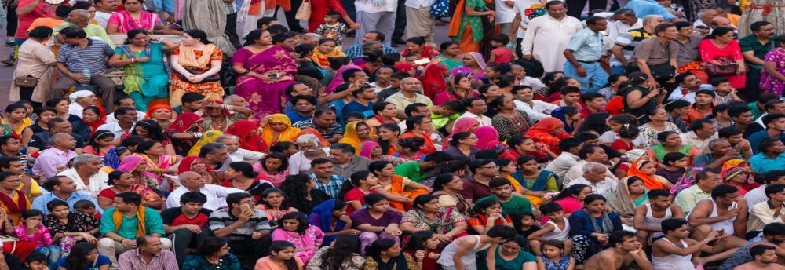
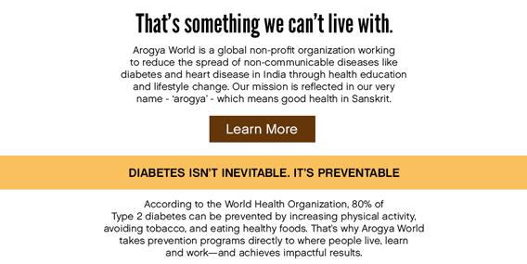
Help Us Make a Healthier India.

Slide 3
NCDs AMONG THE TOP HEALTH
& DEVELOPMENT CRISES OF THE CENTURY
66%
Deaths in the world due to NCDs
80%
OF THESE, 80% ARE IN DEVELOPING COUNTRIES
Global Burden of Disease Report: Unhealthy Eating is the cause of most deaths globally.
Global economic impact is a staggering ~$47 trillion by 2030.
Of this, mental health impact is $17 trillion.

Slide 4
THE PROBLEM
Alarming Disease Burden in India
- >20% of population in India has one chronic disease; 10% have more than one
- 50% population dies from chronic diseases
- 70 million live with diabetes. Diabetes kills 1 million Indians/yr (IDF)
- In metros like Chennai, 75% are either diabetic or pre-diabetic
Indians get diabetes 10 years earlier than in the West
- 2/3 India’s 1 billion plus people < 35 years old = alarming public health crisis over next 20 yrs
Devastating Economic Impact
- The World Economic Forum estimates staggering impact:
Cumulative economic output loss from NCDs (including mental health) in 20 yrs =
$47
trillion
- Serious developmental hurdle says International Diabetes Federation:
25% of a poor Indian family’s income spent on care for one person with diabetes.
- Arogya’s 10,000 women’s survey confirms:
- 25% women spend 25% of household income on NCDs.
- Shockingly, 7% spend 50% of household income on NCDs.
*NCDs = heart disease, diabetes, cancer, chronic lung diseases

Slide 5
THE SOLUTION: PREVENTION!
Compelling Clinical Proof Exists that NCDs Can Be Prevented
According to WHO, a healthy diet, exercise and avoiding tobacco can prevent:
Premature
Heart Disease
Type II
Diabetes
Cancers
8o%
80%
40%
Unhealthy Eating is #1 cause of deaths globally - Global Burden of Disease Report April 2019
Landmark Clinical Trial - Diabetes Prevention Program (DPP):
- 30 min physical activity/ day + low-fat diet reduced chance of getting diabetes by 58%, (Metformin: 31%). 3,234 high-risk adults in the US. (NEJM, Feb 7 2002). sustained for 10 yrs (The Lancet – 2009). Also confirmed in Indian studies

Slide 6


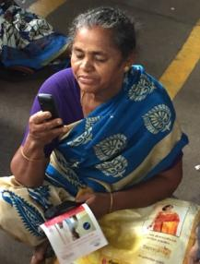

OUR DOORSTEP HEALTH MODEL in INDIA
TAKING PREVENTION TO WHERE PEOPLE LIVE, LEARN & WORK
MyThali
mDiabetes
LIVE
WORK
myArogya
Healthy Workplace
LEARN
Healthy Schools
We are committed to helping people lead healthier lives by preventing NCDs

Slide 7



WHAT DISTINGUISHES AROGYA’S WORK
We are committed to changing the course of chronic disease in India
through prevention.
Arogya’s Doorstep Health Model is a viable solution to a huge societal
problem
Thoughtfully Designed Programs.
Population Level Impact.
Science-based work.
Behavior Change Content and Expertise
Evidence based advocacy.
Having shown proof of concept, we are now in scale-up mode.
Our work meets India’s CSR requirements.
We have partnerships in place that have delivered impactful results
across the country.
We leverage mHealth to extend our reach.
We are committed to impact measurement
SDG #3
Aligned with Sustainable Development Goals (SDGs) and
Government of India priorities (Ayushman Bharat, Fit India, Eat Right campaign, Poshan Abhiyan).
We believe our work will help India meet SDG #3.

Slide 8
WHAT HAVE WE ACHIEVED TO DATE?

Slide 9
WE HAVE REACHED 5 MILLION, IMPACTED 500,000!
mDiabetes
Reach 1.7 million
20% impact
MyThali
45 workplaces
Danone Protein Week
Social Media
Healthy Workplace
>130 companies,
3 million employees
33 Platinum companies
6 annual HW Conference
Advancing physical + mental health
LIVE
myArogya-
NCD Prevention Content
WORK
LEARN
Healthy Schools
Reach 500,000 kids
15% impact
+ 100,000 kids/yr Banda UP
2020 Goal: Educate 10 million; Help 1 million improve their health

Slide 10

WE WORK ALL OVER INDIA
Arogya’s reach in India is extensive, and covers over 12 different Indian States and Union Territories.
mDiabetes
Gujarat
Karnataka
Himachal Pradesh
Madhya Pradesh
Maharashtra
Rajasthan
Tamil Nadu
West Bengal
Healthy Schools
Andhra Pradesh
Assam
Bihar
Haryana
Karnataka
Madhya Pradesh
Maharashtra
Rajasthan
Tamil Nadu
Telangana
Uttar Pradesh
West Bengal
Healthy Workplaces
Andhra Pradesh
Assam
Gujarat
Karnataka
Maharashtra
New Delhi
Uttar Pradesh
West Bengal

Slide 11



























WE HAVE BUILT STRONG PARTNERSHIPS
Donors in Chicago
Jamnalal Bajaj Foundation

Slide 12
OUR PROGRAMS
ARE THOUGHTFULLY DESIGNED

Slide 13

COMPELLING SCHOOL PROGRAM MATERIALS = 15% IMPACT

Slide 14
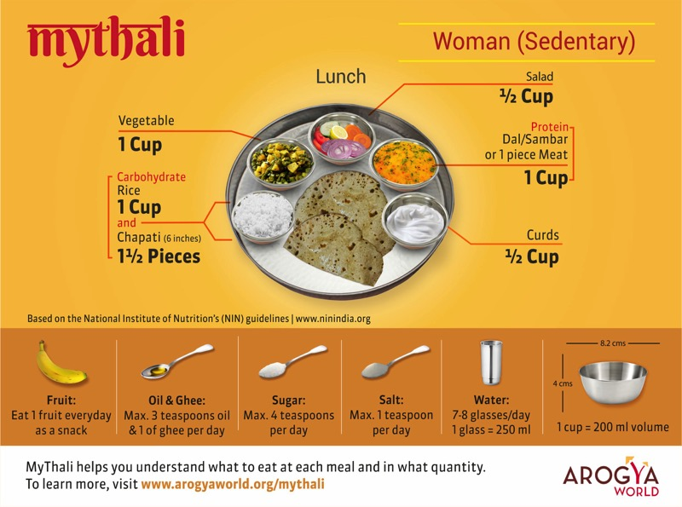
MyThali – EMPOWERING WOMEN TO EAT RIGHT

Slide 15

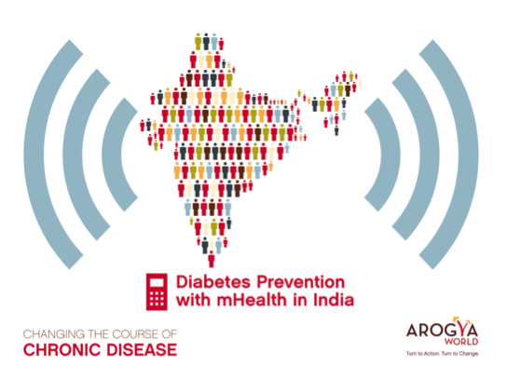

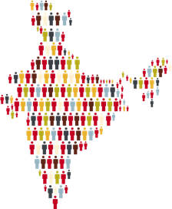




= 20% IMPACT
A groundbreaking one-million-person diabetes awareness and prevention mHealth program in India. A Completed 2011 CGI Commitment to Action.
Our Partners
Behavior Change Task Force
Text Messages in 12 languages sent to 1 million from all over India who opted in,
twice a week for 6 months.

Slide 16
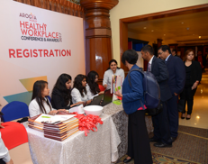
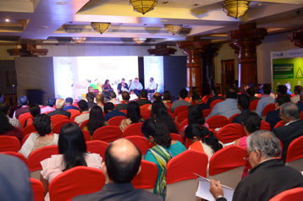
OUR EVOLVING HEALTHY WORKPLACE PROGRAM
131 companies (through 2019), 3 million employees
Lifestyle Change prog
MyThali + Menu Audits
Mental Health Webinars
Hall of Fame
  Workplace Health Champions.
  Fully committed to reporting on metrics
  Improvements on Health Data
  Health Outcomes
Platinum
Track metrics.
Data Driven Culture
Gold
Recognition at Annual
Healthy Workplace Conference and Award Event
Assessment
Rigorous, direct, transparent
in-person assessment
Silver
Bronze
Ban tobacco use
Encourage healthy eating
Increase physical activity
Improve work-life balance
Leadership endorsement
Pre-Accreditation
Companies review criteria and apply
Arogya’s Healthy Living Communications Package will drive Employee Engagement
1-4 YEARS
Beyond the Gold level, a modest one-time participation fee of INR 50,000 is requested per company for the whole journey

Slide 17
MOVING FORWARD

Slide 18


WHERE ARE WE GOING?
IMPACT GOAL: Help 1 MILLION improve their health by 2020
Reach through 2019 = 5 million; estimate 500,000 have improved their health
By the end of 2020, we aim to educate a total of 10 million people
By the end of 2022 - when India will be 75 - we want to educate 22 million
Having shown proof of concept, we are now
AGGRESSIVELY SCALING UP!
By leveraging technology + Government + partners
+ by raising our profile
And at what cost?
  50 cents/person to educate to date (average costs across all our programs)
  Aim for 20 cents / person in the medium term
2018 | 2020 | 2022
4 million | 10 million | 22 million

Slide 19
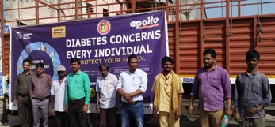
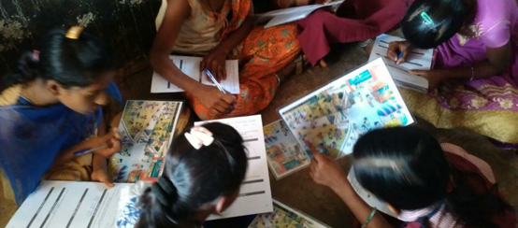
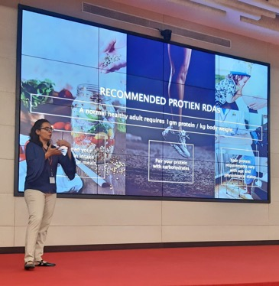
HOW WILL WE GET THERE? OUR ROADMAP
SCHOOLS
Funding in place for 350,000 children
Integrate rural MyThali with schools program
Scale with Government – with States UP (Banda district) + Maharashtra + explore with India’s Ayushman Bharat
Work with Credible Partners with broad reach into young adolescents
Use technology to broaden reach and reduce cost
3rd party validation of results – Stanford’s CARE
MyThali
Empower women, girls to eat right
Use MyThali as a Behavior Change Communications Tool
Promote MyThali in Urban consumers with social media + in Healthy Workplaces
Rural MyThali – Focus on adolescent girls.
Leverage Govt of India interest in nutrition – Poshan Abhiyan
Integrate with School Health
Work with PATH to get expert input.
roll out Rural MyThali in UP community (with PATH) + schools + frontline health workers
Measure impact across all channels with third party
mHealth
Leverage government efforts
Leverage large infrastructure and reach of partners +
excellent mHealth content:
  with Emory : mDiabetes + Digital Heart Health + NCD Prevention modules
  with NIMHANS: Stress Reduction messages
Explore working with Rotary through Health Camps +
with Piramal (Truck drivers + Health Help Lines)
Explore synergies with India’s Health & Wellness Centers

Slide 20
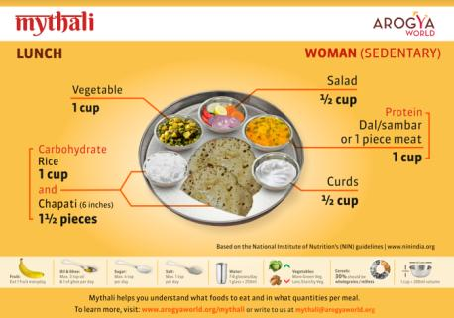

ROADMAP for HEALTHY WORKPLACES
Partner with big partners with broad reach into corporates eg IAOH (Delhi), iNFHRA, Sodexo etc.
Take companies from Gold to Platinum to Hall of Fame, with custom plans on improving health programs
Promote data driven culture of Health
Roll out other Arogya programs to advance the health of individual employees eg MyThali, lifestyle change
Keep companies engaged with webinars, communications materials
Best Practice sharing at Conference
Talks, flyers, posters, year long email campaign, compelling communications, recipes, chef demos, videos etc.
Cafeteria menu audit.
Lifestyle coach led behavior change
Proven - based on landmark clinical trial DPP
Promoted by US CDC + Emory Univ
Brought by Arogya for first time to India
Train the trainer program
Small group sessions
Facilitation techniques and group dynamics designed to increase behavior chnage

Slide 21
HOW WILL WE GET THERE? OUR TIMELINES
Healthy Schools - >150,000
mDiabetes - 1 m +35,000
MyThali – 7,000
HW - 116 companies; 2.5 million employees; 29 Platinum
Healthy Schools – 1 million
mDiabetes – 3.2 million
MyThali – 1.25 million
HW – 200 companies; 4 million employees, 50 Platinum
Healthy Schools – 2.5 million
mDiabetes - 7 million
MyThali - 5 million
HW – 400 companies; 8 million employees; 150 Platinum
2019
2021
2018
2020
2022
Healthy Schools - 500,000
mDiabetes - 1.8 million
MyThali - 250,000
HW – 131 companies, 3 million employees; 33 Platinum
Healthy Schools – 1.6 million
mDiabetes – 5 million
MyThali – 2.5 million
HW - 300 companies, 5.5 million employees; 100 Platinum

Slide 22
THE AROGYA WORLD FAMILY
Arogya World India Trust Board
Dr. Susheela Venkataraman – Chairperson • Ujwal Thakkar • Keshav Desiraju • Dr Ashwin Naik • Dr. Nalini Saligram - Founder Trustee
Arogya World US Board
Dr Nalini Saligram, Founder & CEO • Pamela Yih, CFO • Dr. Seema Bhatia • Deepa Prahalad • Kathryn Graves • Gloria Barone • Denise Freier • Emilie Ninan • Radhika Papandreou • Swati Choudhary • Heather Nornes • Neeru Arora
Consultants/Staff Sumathi Rao – Country Head, India • Usha Chander - Healthy Workplaces • Meeta Walavalkar mHealth & MyThali • Shyamala Sami - Finance • Dr. Sandhya Ramalingam - Program Evaluation • Dr. Geeta Bharadwaj - Healthy Workplaces • Nandini Ganesh - Healthy Schools • Dr Meghana Pasi, Nutritionist • Ashwini Thakker, Healthy Workplaces & Development • Kshema Kurup, Communications • Anju Jayprakash, Data Analysis • Dr Smriti Pahwa, Advocacy •Nandan Bhatia, Healthy Workplaces + Development • Erin Justen, Development • Gene Levin, Finance • Lauren Phillips, Communications • Vijayalakshmi Hareesh, Healthy Workplaces
Experts & Advisors Dr. K. Srinath Reddy –Public Health Foundation of India (PHFI) • Dr. V. Mohan –Madras Diabetes Research Foundation, (MDRF) • Dr. D. Prabhakaran –PHFI • Dr. Nikhil Tandon –All India Institute of Medical Sciences • Dr. K.M. Venkat Narayan – Emory University • Dr. Bonnie Spring –Northwestern University • Dr. Francine Kaufman • Dr. Om P. Ganda • Dr Sethu Reddy • C Mahalingam • Dr Ashish Jain • Dr Balaji Santanam • Prof Maheshwari
Arogya World India Trust is 80G cleared in India.

Slide 23
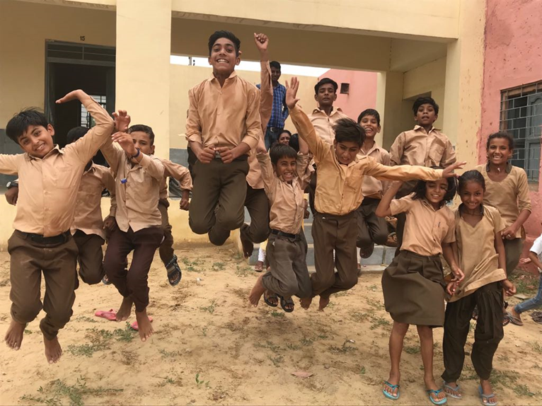

THANK YOU!!!

