Slide 1
CHANGING THE COURSE OF CHRONIC DISEASE… One Community at a Time
Arogya in Sanskrit means good health. More literally to live a life without disease.
Chronic non-communicable diseases called NCDs, include heart diseases, cancer, diabetes and chronic lung diseases

Slide 2
THE PROBLEM: NCDs AMONG THE TOP
HEALTH & DEVELOPMENT CRISES OF THE CENTURY
Deaths in the world
66%
Of these, 80% are in developing countries
80%
Global economic impact is staggering ~$47 trillion by 2030. Of this, mental health impact is $17 trillion.

Slide 3
THE PROBLEM
NCD’s* among top health and development challenges of the century
2 out of 3 deaths in the world due to NCDs, 80% in developing countries
Global Burden of Disease Report says Unhealthy Eating is the cause of most deaths globally
- >20% of population in India has one chronic disease; 10% have more than one
- 50% population dies from chronic diseases - 70 million live with diabetes. Diabetes kills 1 million Indians/yr (IDF) - In metros like Chennai, 75% are either diabetic or pre-diabetic
- Indians get diabetes 10 years earlier than in the West - 2/3 India’s 1 billion plus people < 35 years old = alarming public health crisis over next 20 yrs
Alarming Disease Burden in India
Devastating Economic Impact
- The World Economic Forum estimates staggering impact: Cumulative economic output loss from NCDs (including mental health) in 20 yrs =
$47
trillion
- Serious developmental hurdle says International Diabetes Federation: 25% of a poor Indian family’s income spent on care for one person with diabetes.
- Arogya’s 10,000 women’s survey confirms: - 25% women spend 25% of household income on NCDs. - Shockingly, 7% say they spend 50% of household income on NCDs.
*NCDs = heart disease, diabetes, cancer, chronic lung diseases

Slide 4
THE SOLUTION: PREVENTION!
Compelling Clinical Proof Exists that NCDs Can Be Prevented
According to WHO, a healthy diet, exercise and avoiding tobacco can prevent:
Premature
Heart Disease
Type II
Diabetes
Cancers
8o%
80%
40%
Landmark Clinical Trial - Diabetes Prevention Program (DPP):
- 30 min physical activity/ day + low-fat diet reduced chance of getting diabetes by 58%, (Metformin: 31%)
- 3,234 high-risk adults in the US. (NEJM, Feb 7 2002)
- Diabetes prevention with lifestyle changes sustained for 10 yrs (The Lancet – 2009)
- Also confirmed in Indian studies

Slide 5
WHAT DISTINGUISHES AROGYA’s WORK
Arogya’s Doorstep Health Model for NCD Prevention in India
– a viable solution to a huge societal problem
Population Level Impact.
All our programs are free to the consumer.
Science-based work. Evidence based advocacy
Having shown proof of concept, now in scale-up mode
Increasing reach with credible Partners
Bringing our India Approaches to US healthcare

Slide 6
WE COULDN’T DO OUR WORK WITHOUT
PARTNERS AND SUPPORTERS
Donors in Chicago
Jamnalal Bajaj Foundation

Slide 7
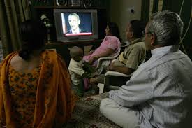
OUR DOORSTEP HEALTH MODEL in INDIA
TAKING PREVENTION TO WHERE PEOPLE LIVE, LEARN & WORK
School
HEALTHY SCHOOLS
Home
mDiabetes
MyThali
Work
myArogya
We have programs for different life stages to reinforce the message
Healthy Workplace

Slide 8
OUR PROGRAMS
ARE THOUGHTFULLY DESIGNED

Slide 9
COMPELLING SCHOOL PROGRAM MATERIALS = 15% IMPACT

Slide 10
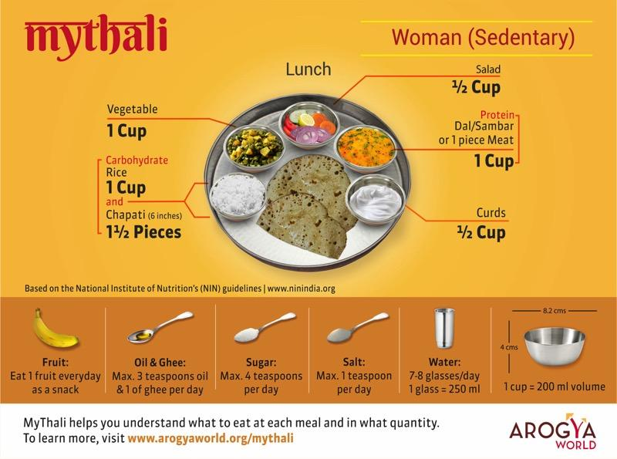
MyThali – EMPOWERING WOMEN

Slide 11
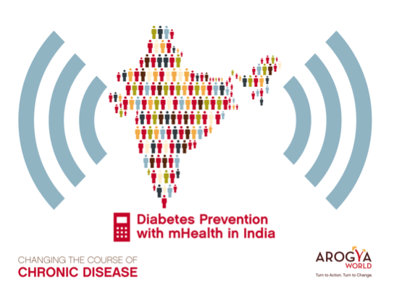
= 20% IMPACT
A groundbreaking one-million-person diabetes awareness and prevention mHealth program in India. A Completed 2011 CGI Commitment to Action.
Our Partners
Behavior Change Task Force
Text Messages in 12 languages sent to 1 million from all over India who opted in,
twice a week for 6 months.

Slide 12
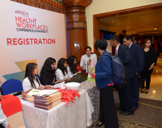
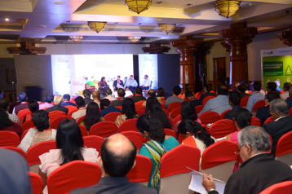
HEALTHY WORKPLACE PROGRAM
131 companies (over 6 years), 3 million employees
Lifestyle Change program
MyThali
Your Kids
Hall of Fame
Workplace Health Champions.
Excellence in health
Fully committed to reporting on metrics
Improvements in health data
Platinum
Track metrics. Estimate ROI from workplace wellness
Gold
Recognition at Annual
Healthy Workplace Conference and Award Event
Assessment
Rigorous, direct, transparent
in-person assessment
Silver
Bronze
Ban tobacco use
Encourage healthy eating
Increase physical activity
Improve work-life balance
Leadership endorsement
Pre-Accreditation
Companies review criteria and apply
1-4 YEARS
Arogya’s Healthy Living Communications Package will drive Employee Engagement

Slide 13
DO OUR INDIA PROGRAMS WORK?

Slide 14
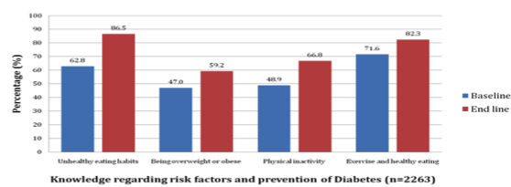
RESULTS FROM SCHOOLS PILOT (2011-2013) AWARENESS INCREASED
Delhi – 2263 students from 6 schools (3 government, 3 private)
Partner: Hriday
Awareness Increased
23.7% more students understood that unhealthy eating habits can put you at risk for diabetes, and
12.2% more students learned that being overweight can increase the future risk for diabetes.

Slide 15
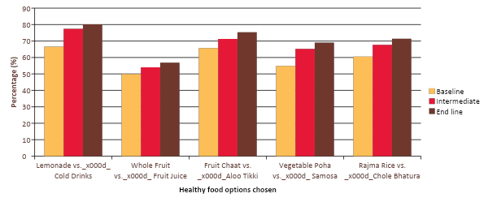
RESULTS FROM DELHI PILOT – 2 EXCITING BEHAVIOR CHANGE
Daily intake of vegetables increased from 61.2% to 76.9% over the two-year program
More kids moved - 52.6 % vs 34.9 % reported going outside and playing with friends
Children consistently reported choosing healthier foods:
more students (75.4% vs 65.7%) chose fruit chaat over alu tikki.

Slide 16
JMIR Aug 2016* mDiabetes RESULTS SIGNIFICANT PUBLIC HEALTH IMPACT
299/611 experimentals improved health behaviors
185/635 controls improved health behaviors
* http://www.jmir.org/2016/8/e207/

Slide 17
PLATINUM HEALTHY WORKPLACES
Promising health trends from 2018 Platinum companies mirror the previous Platinum data trends:
The 7 Platinum companies of 2018, over the previous two years, showed:
28% reduction in smoking or tobacco use
48% increase in employees who exercise regularly
25% reduction in those who had difficulty sleeping
30% reduction in stress
17% increase in those that completed health risk assessments.
3.9% reduction in average recorded blood pressure and
> 14% reduction in triglycerides

Slide 18
WHAT HAVE WE ACHIEVED TO DATE?

Slide 19
WE HAVE REACH into 5 million, IMPACT 500,000
Healthy Schools
Reach 500,000 kids
15% impact
School
mDiabetes
Reach 1.7 million
20% impact +
Healthy Workplace
>130 companies,
3 million employees
33 Platinum companies
6 annual HW Conf
Advancing physical + mental health
Home
mDiabetes US
small Study in Chicago
Work
myArogya
Arogya NCD Prevention
Content
MyThali
45 workplaces
Danone Protein Week
Consumer Promotion
Evidence Based Advocacy – 10,000 women’s Study (UN Side events). Salt Summit.

Slide 20
MOVING FORWARD

Slide 21
WHERE ARE WE GOING?
GOAL: HELP 1 MILLION improve their health by 2020
Reach to date = 5 million; 500,000 have improved their health
By the end of 2020, we will educate total 10 million people
By the end of 2022, when India will be 75, we will educate 22 million
2018 2020 2022
4 m 10 m 22 million
Having shown proof of concept, we are now
AGGRESSIVELY SCALING UP!
Going deeper to make greater impact
Leverage our US and India reach; expand to
Middle East and Mexico
Raise our profile
And at what cost?
50 cents/person to educate to date
(average costs across all our initiatives)
$5-6/person to make impact
20 cents / person to educate going forward

Slide 22
EVIDENCE - BASED ADVOCACY
WE ASKED 10,000 WOMEN ABOUT IMPACT OF NCDs

Slide 23
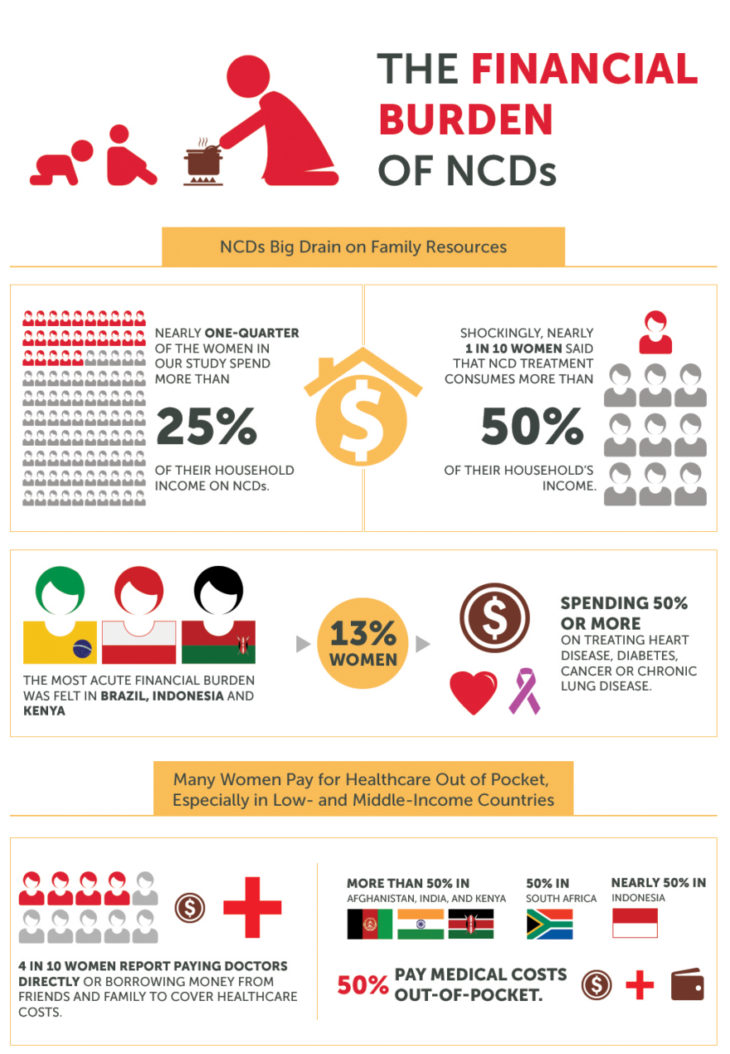
GRASSROOTS DATA SCREAM FOR UHC
25% SPEND 25% INCOME ON NCDs

Slide 24
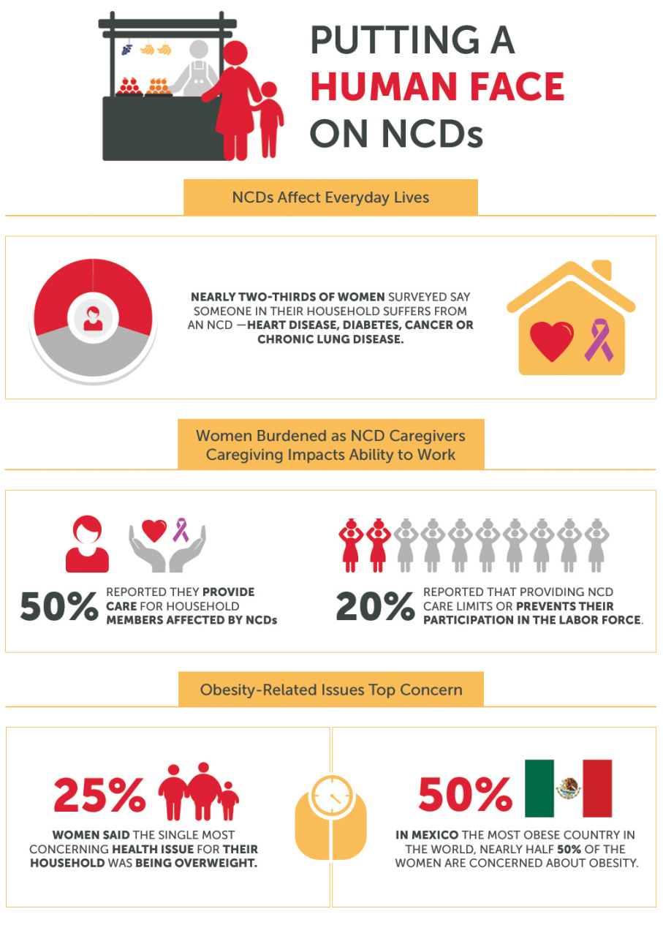
50% PROVIDE CARE FOR NCDs - UNPAID WORK
MUST BE ADDRESSED IN A POST-2015 WORLD

