Slide 1
CHANGING THE COURSE OF CHRONIC DISEASE… One Community at a Time
Arogya in Sanskrit means good health. More literally to live a life without disease.
Chronic non-communicable diseases called NCDs, include heart diseases, cancer, diabetes and chronic lung diseases

Slide 2
INTRODUCING AROGYA WORLD
Arogya World, formed in 2010, is a global health non-profit working to prevent non-communicable diseases (NCDs) through health education and lifestyle change.
We strive to achieve our mission - to change the course of chronic disease – through a focus on partnerships and innovative technology, and by implementing scalable, sustainable programs with measurable impact.
Two separate non-profit legal entities
- Arogya World – Chicago based 501(c) 3 organization
- Arogya World India Trust – Bangalore based 80G cleared organization

Slide 3
THE PROBLEM
NCD*s among top health and development challenges of the century - 2 out of 3 deaths in the world due to NCDs, 80% in developing countries
Alarming Disease Burden in India - >20% of population in India has one chronic disease; 10% more than one - 50% population dies from chronic diseases - 65 million live with diabetes. Diabetes kills 1 million Indians/yr (IDF) - Indians get diabetes 10 years earlier than in the West - ½ India’s 1 billion plus people < 25 years old = alarming public health crisis over 20 yrs
Devastating Economic Impact - The World Economic Forum estimates staggering impact: Cumulative economic output loss from NCDs (with mental health) in 20 yrs = $47 trillion
- Serious developmental hurdle says International Diabetes Federation: 25% of a poor Indian family’s income spent on care for one person with diabetes.
- Arogya’s 10,000 women’s survey confirms: 25% women spend 25% of household income on NCDs, Shockingly, 7% say they spend 50% of household income on NCDs.
*NCDs = heart disease, diabetes, cancer, chronic lung diseases

Slide 4
STRONG SCIENTIFIC RATIONALE FOR OUR WORK
Compelling Clinical Proof Exists that NCDs Can Be Prevented
WHO: a healthy diet, exercise and avoiding tobacco can prevent
- 80% of premature heart disease,
- 80% type II diabetes and
- 40% of cancers
Landmark Clinical Trial - Diabetes Prevention Program (DPP)
- 30 min physical activity/ day + low-fat diet reduced chance of getting diabetes by 58%, (Metformin: 31%)
- 3,234 high-risk adults in the US. (NEJM, Feb 7 2002)
- diabetes prevention with lifestyle changes sustained 10 yrs The Lancet (2009)

Slide 5
OUR SOLUTION – GLOBAL AND LOCAL
Engage Leaders, Rally The World, Change Policy
Engage with Member States: 10,000 Women NCD Impact Global Survey
Mobilize world & business leaders, policy makers and the general public on prevention
Op-eds, blogs, social media, case studies
On the Ground Prevention Programs
Multipronged approach in India - schools, workplaces and mHealth.
Engage the individual. Bring about behavior change known to prevent diabetes
Measurable, scalable impact.
Chronic Disease Prevention Model for the Developing World

Slide 6
AROGYA WORLD PHILOSOPHY
Focus on NCD education and prevention
Create compelling, science-based, scalable programs
Monitor impact on a continuous basis
Partner with others to yield effective solutions

Slide 7
OUR PARTNERS AND SPONSORS
Healthy Workplace
PHFI, Aon, NationWide, iTiffin
Schools
HRIDAY-SHAN, Merck, MSD-India, Agastya Foundation
Novartis, Partnership to Fight Chronic Disease, American Cancer Society, UNICEF, Abt SRBI, Jana, PSI
mHealth2.0
CIGNA Foundation
Other Partners
Duane Morris, Ujjala Foundation, NCD Roundtable, Women & NCDs Task Force, Madras Diabetes Research Foundation

Slide 8
AROGYA WORLD GROWTH
1-2 Years
3-4 Years
5+ Years
US non-profit March 8, 2010
Schools
2-year (2011-2013) Delhi Pilot Merck funding – good results.
mDiabetes
2011 CGI Commitment, many partners, with Nokia reached 1 million in India, measured effectiveness
Healthy Workplace Criteria 2012
Healthy Workplace Awards
2013 CGI Commitment 9 companies 2013, 20 in 2014 Expand to schools in S. India
Complete mDiabetes Publish.
India Trust / 80G cleared (2012)
Helped 150,000 Indians lead healthy lives
10K Women Global NCD Impact Survey
2013 CGI Commitment. Promote results + Videos. Influence change.
.
mHealth2.0 - Expand to other NCDs
mCessation - Indianize
NCD Prevention mobile “app”
100 plus Healthy Workplaces
UN Every Woman Every Child 10,000 children Commitment
Drucker Award Finalist
Women’s empowerment – My Thali
Chronic Disease Prevention Model
Sustainable Business Model

Slide 9
ADVANCING THE FIGHT AGAINST NCDS GLOBALLY

Slide 10
10,000 WOMEN’S GLOBAL SURVEY
Though NCDs are #1 killer of women, data on women’s views on NCDs are scarce
Aim – Capture the voices of women from around the world on the impact of NCDs on their lives, and use the data to inform and inspire multi-stakeholder action
Arogya World’s 2013 CGI Commitment with Novartis, Partnership to Fight Chronic Disease, American Cancer Society, UNICEF, PSI, Abt SRBI and Jana
- Quantitative survey among 10,000 women, 2014
- 10 Countries - Afghanistan, Brazil, India, Indonesia, Kenya, Mexico, Russia, South Africa, UK, US
- Urban women in Afghanistan, Russia, Mexico. Urban + Rural women in others
- Used mobile, web technologies (in person in Afghanistan)
UN side event - July 11 2014: positive multistakeholder reactions to 1st results
- Co-sponsored by US and Mexico governments.
- Attended by 14 Member States and UN Women, UNICEF, UNDP and WHO
Report, Videos, Infographics launched at CGI September 2014.
- Will be used to influence policymakers to make change

Slide 11
SURVEY RESULTS

Slide 12
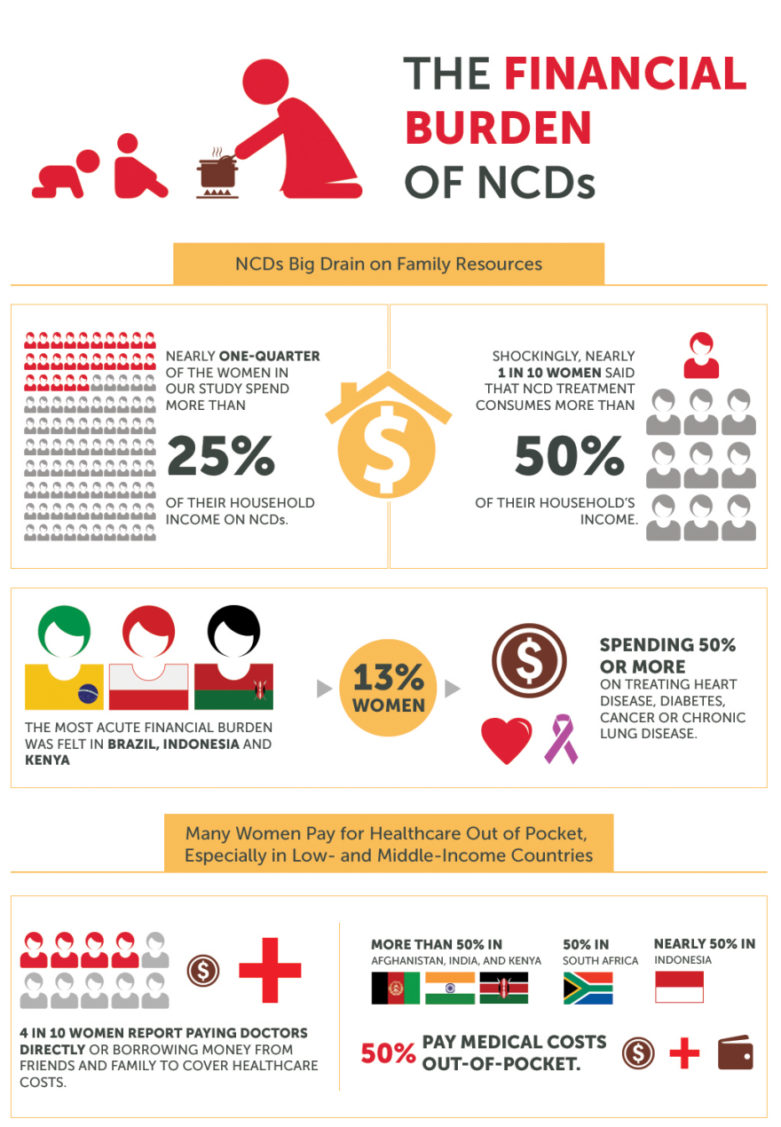
INFOGRAPHICS -1

Slide 13
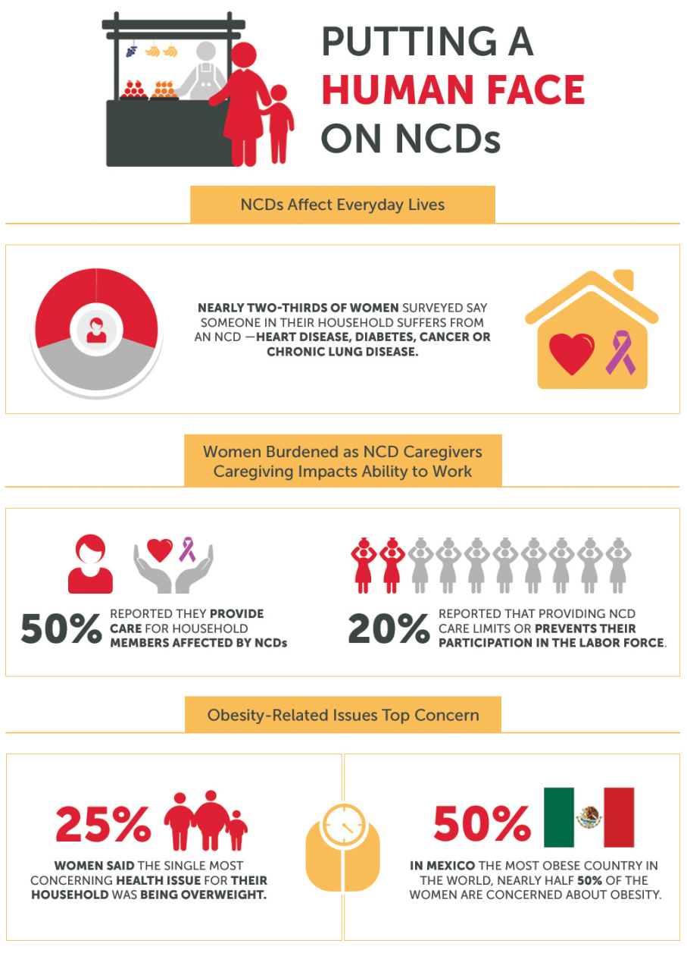
INFOGRAPHICS -2

Slide 14
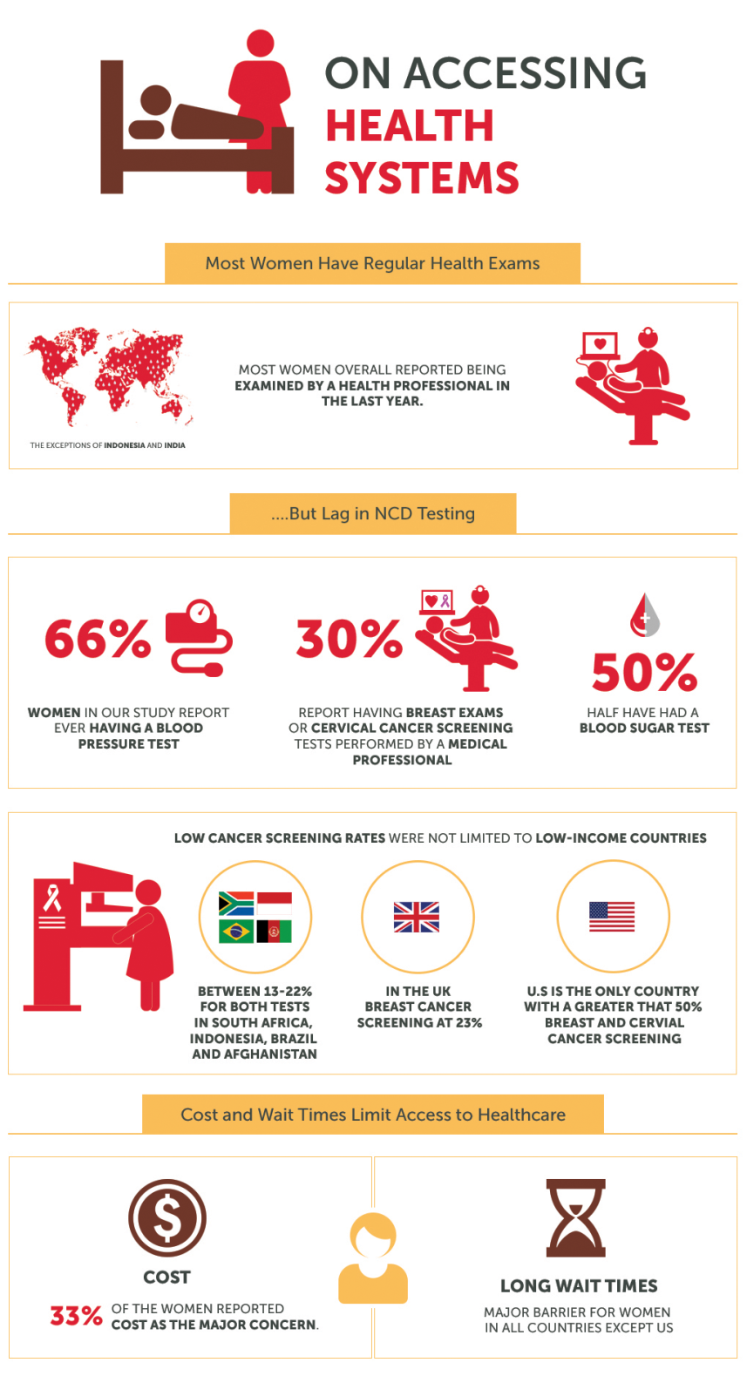
INFOGRAPHICS - 3

Slide 15
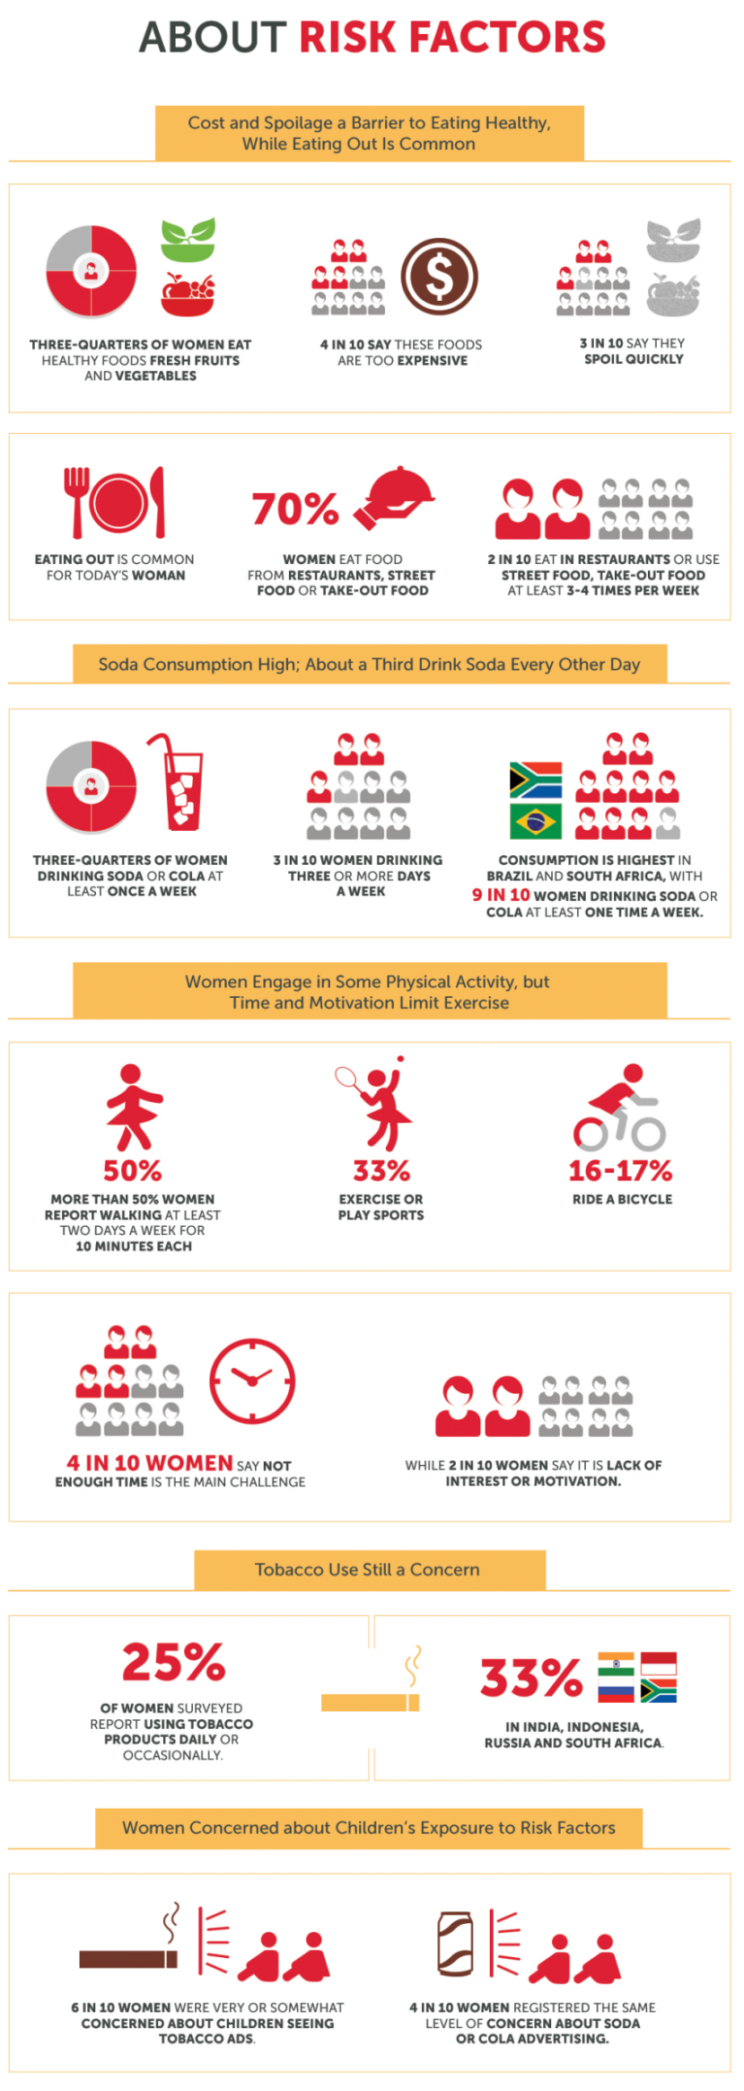
INFOGRAPHICS – 4

Slide 16
OUR INDIA STORY

Slide 17
OUR INDIA PROGRAMS
Schools
Healthy Workplace
mHealth
- mDiabetes
- mHealth2.0
MyThali

Slide 18
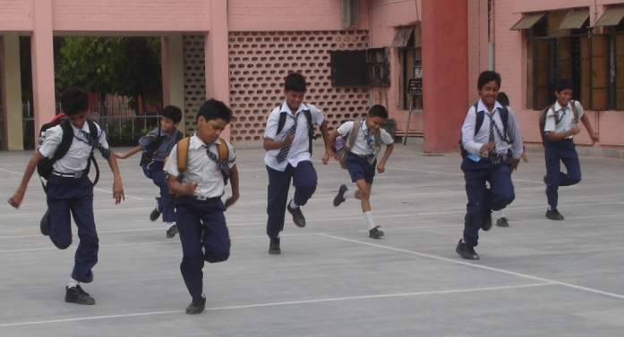
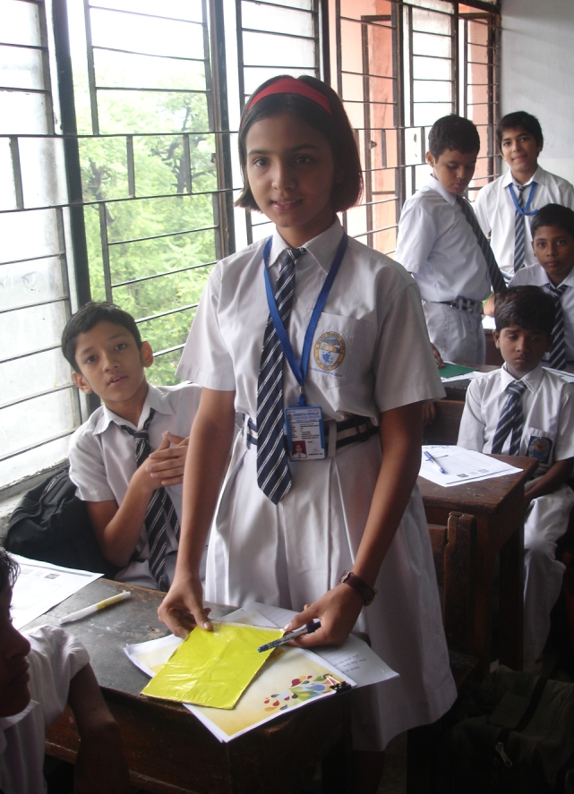
LEVERAGING SCHOOLS AS PLATFORM FOR DIABETES PREVENTION IN INDIA
2014 United Nations
Every Woman Every Child Commitment

Slide 19
OUR SCHOOL PROGRAM
Our Approach
- Use trained teachers & peer-leaders for implementation.
- Based on Hriday’s tobacco control model.
Delhi Pilot – 2011-2013. Two Year Program with HRIDAY.
- Supported by Merck.
- Developed classroom-based, age appropriate educational modules
- Trained teachers and 4 student leaders per class of 40 kids.
- Total 6 schools in Delhi – 3 government, 3 private.
- Reached about 2,000 children in 6th, 7th, 8th grades (11-13 years old)
- Conducted pre- & post-intervention surveys to assess impact.
- Poster-making and skit competitions helped mobilize school community

Slide 20
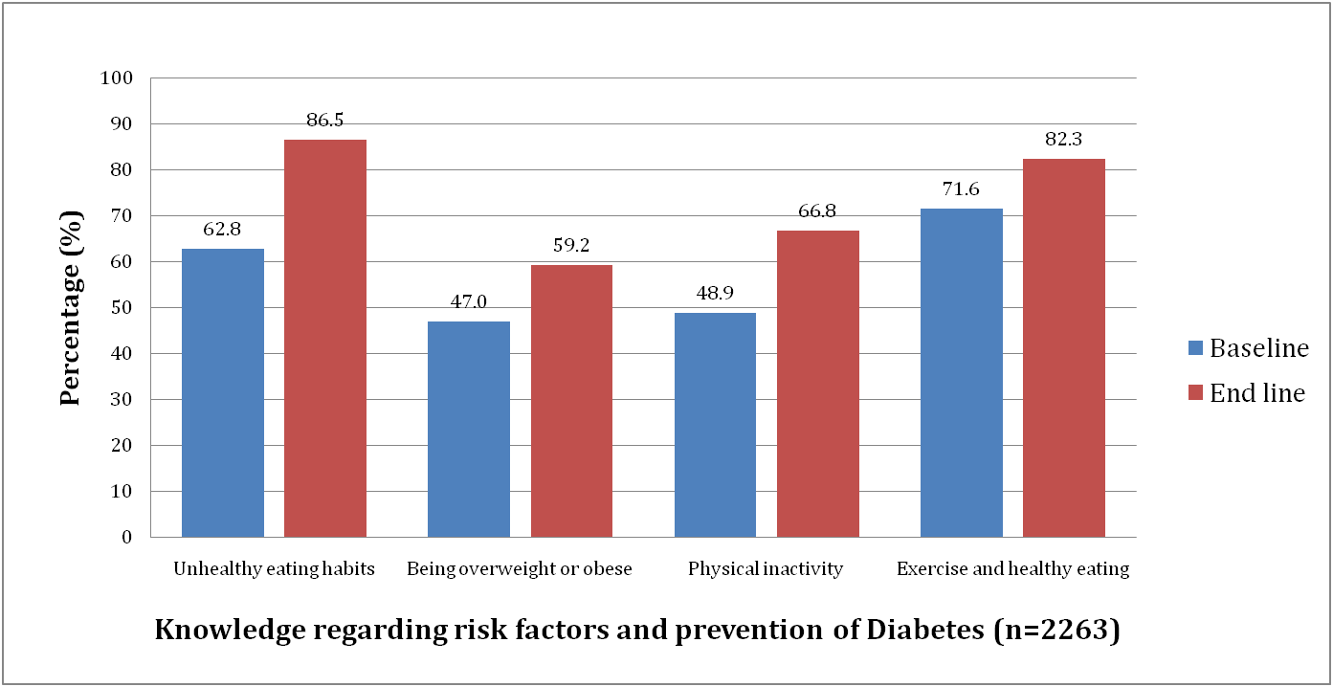
EFFECTIVENESS RESULTS AWARENESS INCREASED, EXCITING BEHAVIOR CHANGE

Slide 21
PROGRAM EXPANSION
Program Shown to be Effective in Urban North India (Hriday Delhi pilot)
Expanding currently to Rural South India
Made UN Every Woman Every Child 2014 Commitment
Educating 10,000 children in 5 yrs
In Partnership with Agastya International Foundation
- Integrated with their Young Instructional Leader program
Arogya will analyse all results and take to Government of India for scale up

Slide 22
OUR HEALTHY WORKPLACE PROGRAM

Slide 23
WHY INVEST IN HEALTHY WORKPLACES?
Workplace wellness improves employee health and productivity, reduces health care costs and helps in employee retention
Reports reveal that smokers miss more than 50% days per year costing employers billions of dollars and diabetes creates more than 15 million work days of absence
Meta-analysis shows corporate wellness on average reduces sick leave absenteeism by 28%, healthcare costs by 26% and workers compensation claims by 30%
Employees who participate in wellness programs are more likely to be loyal to their employer
Sources: summarized in http://visual.ly/why-corporate-wellness

Slide 24
LEVERAGING THE WORKPLACE TO PREVENT CHRONIC DISEASE
Healthy Workplace Awards
Recognize workplaces that promote good health and promote NCD prevention
mDiabetes
Send messages to consumers who opt-in, on mobile phones, to modify behavior for prevention of diabetes
mCessation
Send messages to those who want to stop smoking to modify behavior and help them quit
Lifestyle Coach led Diabetes prevention sessions
Offer on-line and in-person training/coaching
Partner Workplace Wellness Offerings
Healthy meals, Online Lifestyle Coaching Habits program

Slide 25
OUR HEALTHY WORKPLACE AWARD PROGRAM
2013 Clinton Global Initiative Commitment
- Make 100 companies Healthy Workplaces and
- Help 1 million employees lead healthy lives, by 2016.
- Arogya World’s Partners -Public Health Foundation of India, Aon, NationWide
Benchmarking companies in India against a pioneering set of criteria
- Criteria developed for India with multi-stakeholder input http://www.arogyaworld.org/our-work-in-india/healthy-workplaces/healthy-workplaces-criteria/
- Bronze, Silver, Gold Awards Criteria cover No -Tobacco policy, healthy eating and exercise promotion, work life balance and shifting mindset.
- Formal assessments (3 person team – one industry expert, one medical person, one from Arogya) with site visits. Distribute awards at formal Event
Measure retention, loyalty, productivity, and establish ROI from workplace wellness in India

Slide 26
WHAT WE HAVE ACHIEVED TO DATE
2013
- Award Event November 12, 2013 in Bangalore.
- 9 pioneering companies became the first Healthy Workplaces in India – IGate, GE Healthcare, Reliance Infrastructure (Mumbai) Transmission, MTR Foods, Emami United (Abhoypur), Infotech Enterprises Limited, Myntra Designs, Quinnox, Aon
- Full page Ad in Business Standard Nov 14, 2013 to mark World Diabetes Day, congratulate Healthy Workplaces
2014
- 20 more companies including Tata Chemicals, BPCL, Exide, Reliance (Communications), some Aditya Birla companies, Larsen & Toubro, CapGemini, Qualcomm, Honeywell, Brocade etc.
- Award Event on November 11, 2014 in Bangalore. Best Practice Sharing Workshop.
- Newspaper Ad to congratulate winners.
- New partners join hands with Arogya – Jana Care, iTiffin, Karnataka Health Promotion Trust,
Frost & Sullivan etc.

Slide 27
FIRST OF INDIA’S HEALTHY WORKPLACES - 2013

Slide 28
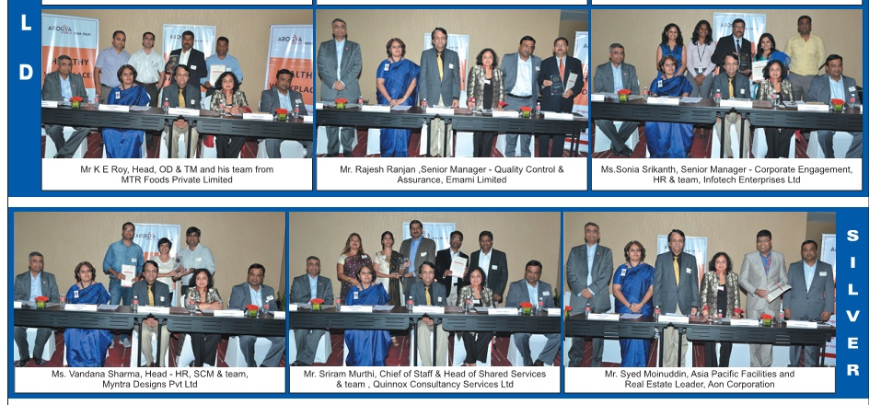
FIRST OF INDIA’S HEALTHY WORKPLACES - 2013

Slide 29
OUR FLAGSHIP PROGRAM = mHEALTH1.0
A groundbreaking one-million-person diabetes awareness and prevention mHealth program in India. A Completed 2011 CGI Commitment to Action.
Our Partners:
Behavior Change Task Force

Slide 30
mDIABETES: CONTENT
High blood sugar from diabetes can cause problems in your eyes, kidneys, heart, feet and nerves.
Type 2 diabetes can be avoided by doing physical activity and eating healthy foods. This has been shown by medical studies.
Physical activity includes daily activities: walking, climbing stairs or household work. It also includes planned exercise: morning walk, sports or yoga.
Small changes in the way you eat can help you avoid diabetes. Eat more vegetables and fruits. Eat less rice and roti.

Slide 31
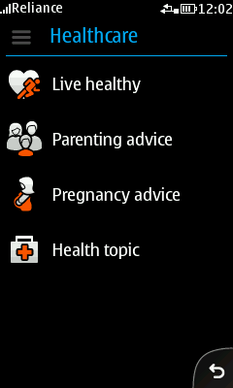
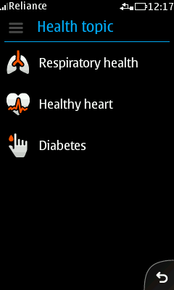
HOW WERE THE MESSAGES SENT TO CONSUMERS?
Nokia Life provides users with a simple browsing interface on their mobile to explore the application and subscribe to the service
User navigates the application through a simple graphic menu.
Graphics on these class of devices are an industry first
Service is available in 11 Indian languages + English

Slide 32
EFFECTIVENESS EVALUATION – METHODOLOGY
Experimental
- Adult- male or female
- 18 years and above
- Nokia Life subscriber
- Opted in to Diabetes Service
Control
- Adult- male or female
- 18 years and above, not a Nokia Life Subscriber
Telephone Interviews
Pre-Intervention Behavior Evaluation
Control Group
Experimental Group
N=943
6 Months of Intervention
N=982
Post-Intervention Behavior Evaluation
Control Group
Experimental Group
N=632 N= 611

Slide 33
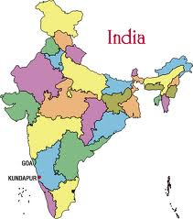
CONSUMER RESPONSES COLLECTED FROM ALL OVER INDIA (2012)
North
Delhi
Haryana
Uttar Pradesh
Bihar
Rajasthan
Gujarat
Madhya Pradesh
Chhattisgarh
Maharashtra
Odisha
Goa
(9) HR
(76) DEL
(2) UK
BIH
(4) RAJ
(27) UP
(3)
(1) GUJ
(74) MP
(11) CHH
(178) MH
(1) OD
South
Tamil Nadu
Kerela
Karnataka
Andhra Pradesh
(75) AP
(39) KR
(4) GOA
4
(194) TN
(70) KER

Slide 34
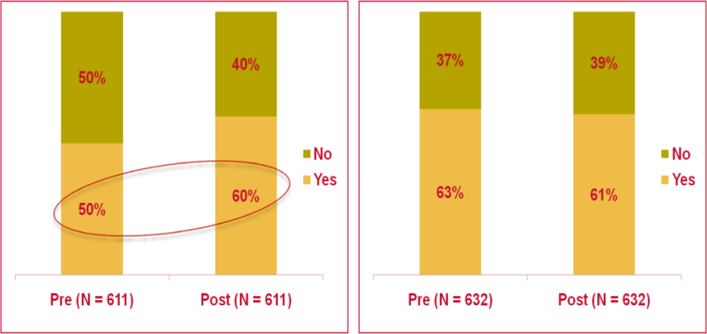
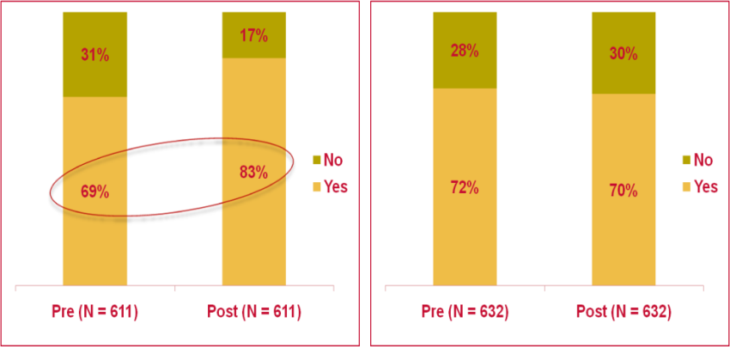
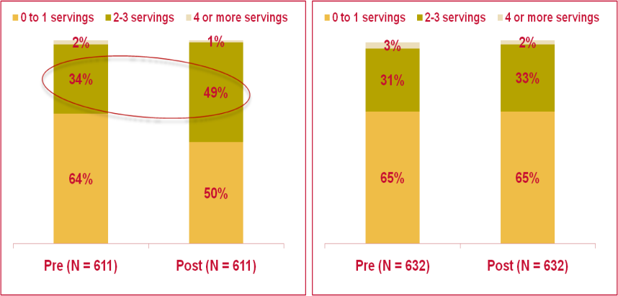
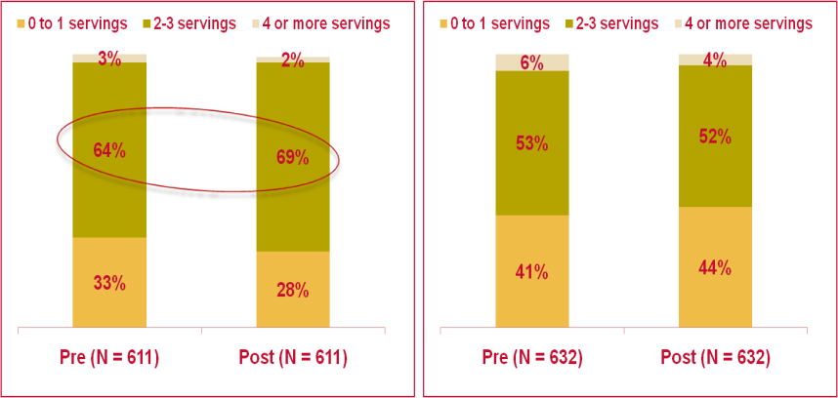
KEY EFFECTIVENESS DATA
Experimental
Control
Experimental
Control
0.001
0.000
Exercise
Avoiding fatty/fried food
0.000
0.15
Eating fruits
Eating vegetables
Statistically significant at 95% confidence;
Statistically significant at 80% confidence;
p-value

Slide 35
CONSIDERABLE IMPACT
15% SHOW MULTIPLE HEALTHY BEHAVIORS
Experimental
Pre (N=611)
Post (N=611)
Respondents who exercise regularly
306 (50%)
366 (60%)
Respondents who consistently avoided fatty/fried food
218 (36%)
310 (51%)
Respondents who ate 2-3 servings of fruits
84 (11%)
181 (30%)
Respondents who ate 2-3 servings of vegetables
62 (10%)
15% Impact
153 (25%)
Caveat: Only positive behavior was scored for. It includes –ve ->+ve; +ve->+ve; +ve->-ve

Slide 36
LITTLE OR NO CHANGE SEEN IN CONTROLS
Control
Pre (N=632)
Post (N=632)
Respondents who exercise regularly
400 (63%)
383 (61%)
Respondents who consistently avoided fatty/fried food
311 (49%)
296 (47%)
Respondents who ate 2-3 servings of fruits
103 (16%)
106 (17%)
Respondents who ate 2-3 servings of vegetables
64 (10%)
No Change
72 (11%)
Caveat: Only positive behavior was scored for. It includes –ve ->+ve; +ve->+ve; +ve->-ve

Slide 37
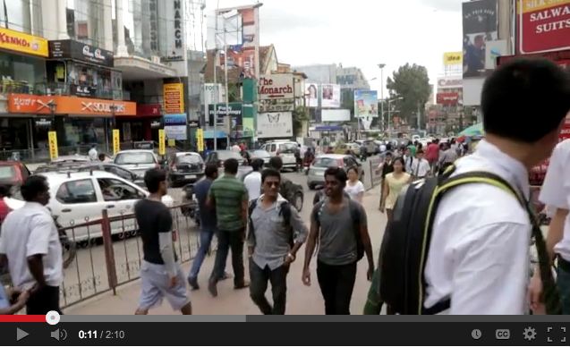
VIDEO SHOWN AT PLENARY SESSION
CGI ANNUAL MEETING SEP 2013
Recognition
- Finalist for 2014 Drucker Award
- Won 2013 mBillionth Award
- Finalist 2013 Vodafone Mobile4Good
- Finalist 2012 Meffys

Slide 38
mHealth2.0
mDiabetes = mHealth1.0
- Population-level program
- effective, scalable
- Estimated to have helped 150,000 Indians lead healthier lives (2012-2013)
Expand to mHealth2.0
- Sponsored by CIGNA Foundation
- heart disease/stroke, kidney disease awareness + prevention
- Effectiveness in Randomized Control Trial in Healthy Workplaces
- Measure Behavior Change + Blood/Urine biochemical markers
- Build diabetes prevention mobile ‘app’ targeting Indians
- mDiabetes, mHealth2.0, mCessation (for smoking cessation)
- Nutritional guide to Indian foods, food /activity tracker,
- Indian Diabetes Risk Score, MyThali

Slide 39
MyThali – EMPOWERING WOMEN
Phase I
- Develop MyThali – new nutritional icon for India with input of global experts
Phase II
- Mass produce educational flyers + plastic prototypes that bring to life a balanced meal
- Distribute to school children with partners like Hriday, Agastya,etc.
- Promote to women to empower them to steer their families towards healthy living
- Distribute to Healthy Workplace employees
- Get flyers inserted into healthy food packages
- Distribute to consumers at retail outlets and malls
- Engage media, seek celebrity endorsement
- Work with chefs to promote MyThali and healthy meals. Promote videos. Integrate with mobile ‘app’.

Slide 40
NEXT STEPS
Help 1 million people lead healthy lives over 10 years (by 2019)
Build a sustainable business model in India
Build chronic disease prevention model for developing world
Expand to other geographies with world authorities

Slide 41
THE AROGYA WORLD FAMILY
Arogya World Board (US)
Dr. Nalini Saligram - Founder & CEO • Dr. Pamela Yih - Treasurer, Owner Pamela Y-F Yih Inc.
Kathryn Graves - Head of Development, Emory Univ Rollins School of Public Health
Dr. Neelum Aggarwal - Rush University Medical Center • Dr. Seema Bhatia - Internist
Deepa Prahalad - Business strategist • Parminder Batra - Attorney, Entrepreneur
Arogya World India Trust Board (India)
Mr. BS Ramaswamy - Chairman of the Board of Trustees • Dr. Nalini Saligram - Founder Trustee
Dr. Susheela Venkataraman - Chief Technology Officer, Asian Development Bank Dr. Arun Gowda – Dir., Phamax AG, Market Access Consulting • Ujwal Thakkar - Former Head of Pratham
Consultants/Staff
Shyamala Sami - Finance India • Dr. Sandhya Ramalingam - Program Evaluation, India
Dr. Geeta Bharadwaj - Healthy Workplaces, India • Bala Aryan - Business Development, India
Nandini Ganesh - Administrative Services, India • Karen Love - Administrative Services, US
Carrie Hutchison - Digital and Social Media, US • mHealth Business, India (TBD)
Accountants - Robert Small & Associates – Philadelphia • Nityanand & Company – Bangalore
Arogya World is a 501(c)3 organization in the U.S. Arogya World India Trust is 80G cleared in India.

Slide 42
AROGYA INFLUENCER NETWORK
Senior Advisors
Mr. Raj Dave – CEO, HealthArc • Dr. Meryle Melnicoff - Former Board Member, Arogya World
Behavior Change Task Force US: Dr. Fran Kaufman - Medtronic • Dr. Linelle Blais - Emory University
UK: Ms. Zoe Hellman - Weight Watchers
India: Dr. Ranjani Harish • Dr. Mohans - Diabetes Specialities Centre • Dr. Monika Arora - Hriday-Shan Mr. Sukanti Ghosh - APCO Worldwide • Dr. Kanav Kahol – PHFI
Indo-US Scientific Steering Committee India: Dr. K.Srinath Reddy – Public Health Foundation of India • Dr. V. Mohan - Madras Diabetes Research
Foundation Dr. Ashok K. Das - Addnl Dir Gen Health Services • Dr. Prabhakaran - Centre for Chronic Disease
Control - Dr. Nikhil Tandon - All India Inst. of Medical Sciences • Dr. Prasanna Kumar - Bangalore Diabetes Hospital
US: Dr. K.M. Venkat Narayan - Emory University • Dr. Francine Kaufman - Medtronic • Dr. Sethu Reddy, Joslin Diabetes Center, Harvard • Dr. Om Ganda - Joslin Diabetes Center, Harvard • Dr. Bonnie Spring – Northwestern
Advisors
Dr. A. Ramachandran - India Diabetes Research Foundation • C.V. Madhukar Omidyar Dr. Arun Chockalingam - University of Toronto • Dr. David C. U’Prichard - Druid Consulting

